Slide 1



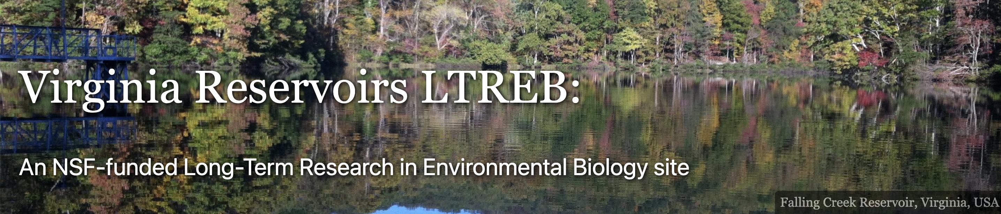
Macrosystems EDDIE: Using High-Frequency Data to Manage Water Quality
Lofton, M.E., Cooke, R.L., and Carey, C.C. 15 August 2024.
Macrosystems EDDIE: Using High-Frequency Data to Manage Water Quality.
Macrosystems EDDIE Module 9, Version 1.
https://serc.carleton.edu/dev/eddie/teaching_materials/modules/module9.html
Module development supported by NSF EF-2318861.
Notes:
Welcome to the Macrosystems EDDIE module: Using High Frequency Data to Manage Water Quality. This module has been developed in collaboration by water treatment instructors at Mountain Empire Community College and freshwater scientists at Virginia Tech. The module is part of the Macrosystems EDDIE program, which stands for Environmental Data-Driven Inquiry and Exploration, and is supported by a grant from the United States National Science Foundation.

Slide 2
Overview of today
Introduce concepts related to assessing water quality and collecting high-frequency water quality data
Activity A: Access and explore high-frequency water quality data from a drinking water reservoir in southwest Virginia
Activity B: Use high-frequency water quality data to make water treatment plant operation decisions
Activity C: Make water treatment decisions using water quality forecasts
Notes:
This module includes three activities, which are all designed to introduce concepts related to assessing water quality and collecting high-frequency water quality data. In Activity A, students will access and explore high-frequency water quality data from a drinking water reservoir in southwest Virginia. In Activity B, students will use high-frequency water quality data from the reservoir to make water treatment plant operation decisions regarding extraction depth. In Activity C, students will make water treatment decision using forecasts of water quality.

Slide 3
Our focal question for today:
How can we use high-frequency data to improve water quality?
Notes:
All of the activities are designed to address the focal question for this module, which is: How can we use high-frequency data to improve water quality?

Slide 4
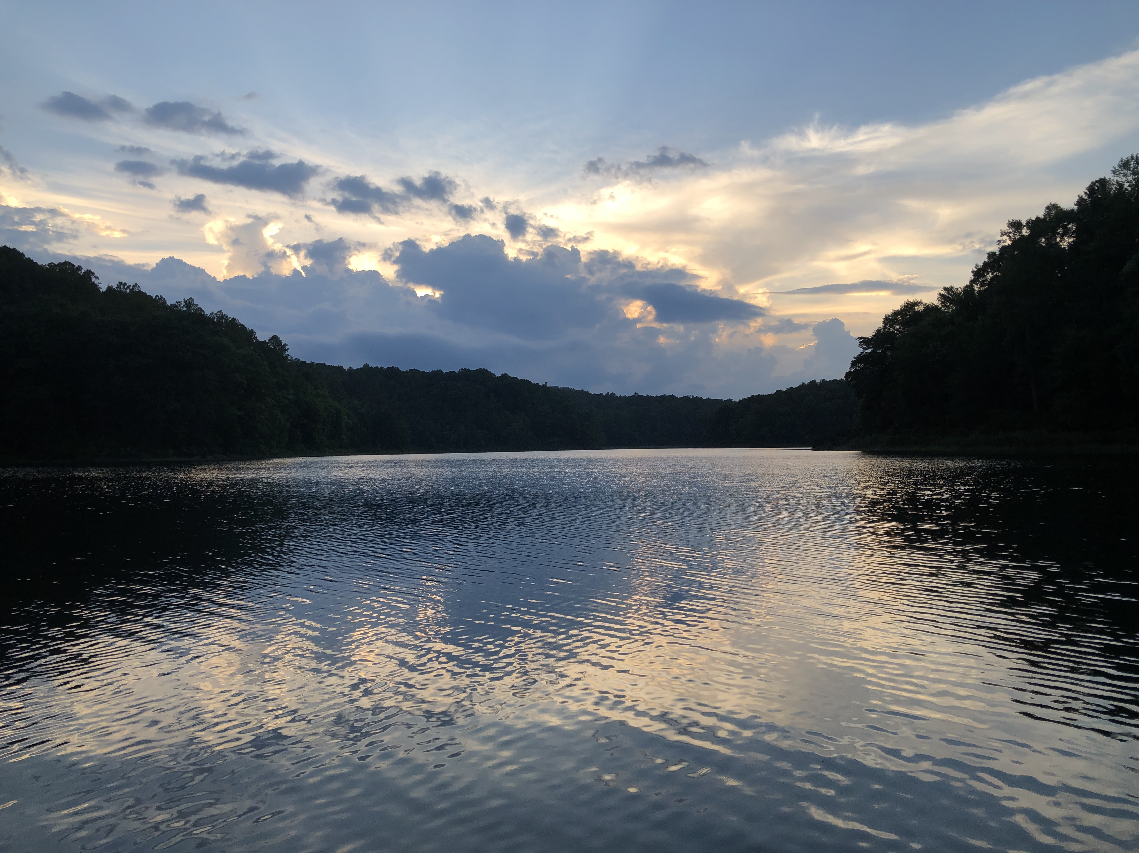
What is water quality?
Suitability of water for human use
drinking water
swimming
Ability to support important ecosystem processes
sustaining a fish population
Notes:
To address this question, we first need to understand what is meant by water quality. Water quality has two components: first, the suitability of water for human uses, such as drinking, recreation, irrigation, and so on. Second, the ability of the water body to support important ecosystem processes, such as sustaining a healthy fish population.

Slide 5
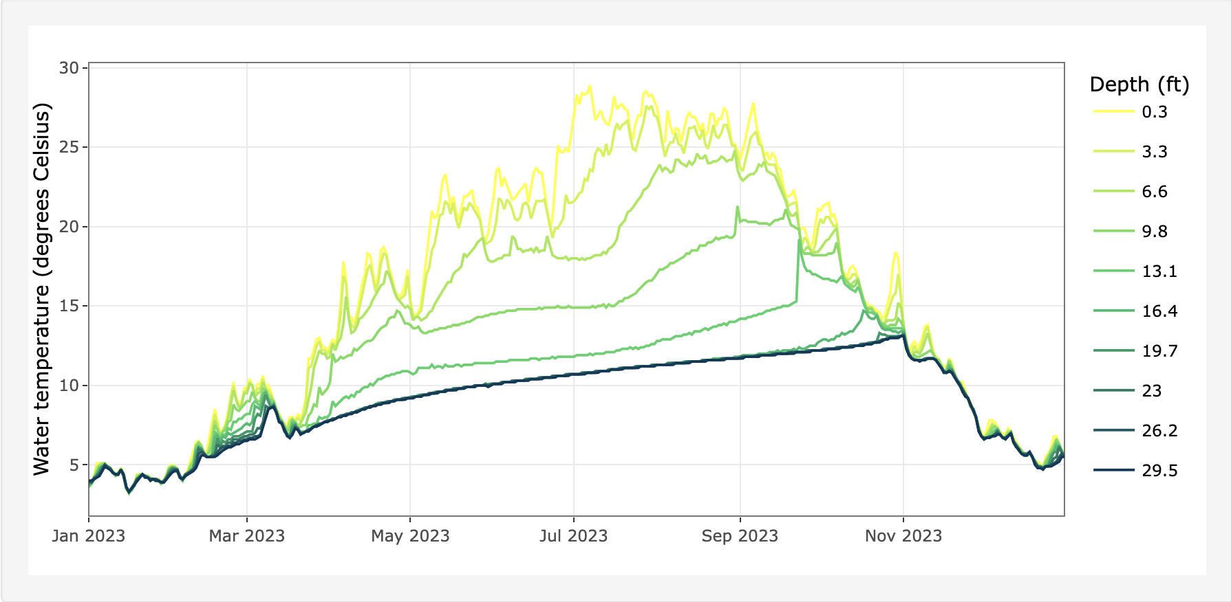
What are high-frequency water quality data?
Measurements taken many times per day or week (for example, every 10 minutes or every day)
Allows managers and scientists to see patterns that were not observable using low-frequency (for example, once a week or once a month) data
Notes:
High-frequency water quality data are measurements of various attributes of a water body (such as temperature, dissolved oxygen, pH, etc.) that are taken many times during a day or during a week (for example, every 10 minutes). This is different from low-frequency data, which are only collected perhaps once a week or even once a month. High-frequency data allow water managers and scientists to observe and analyze patterns and trends in water quality that were not previously measurable using low-frequency measurements. For example, the plot on the bottom of the slide shows water temperature data collected from many different depths in a reservoir every day over the course of a year. You can see there is a lot of variability in this data that would not be visible if the data were collected once a month, for example.

Slide 6
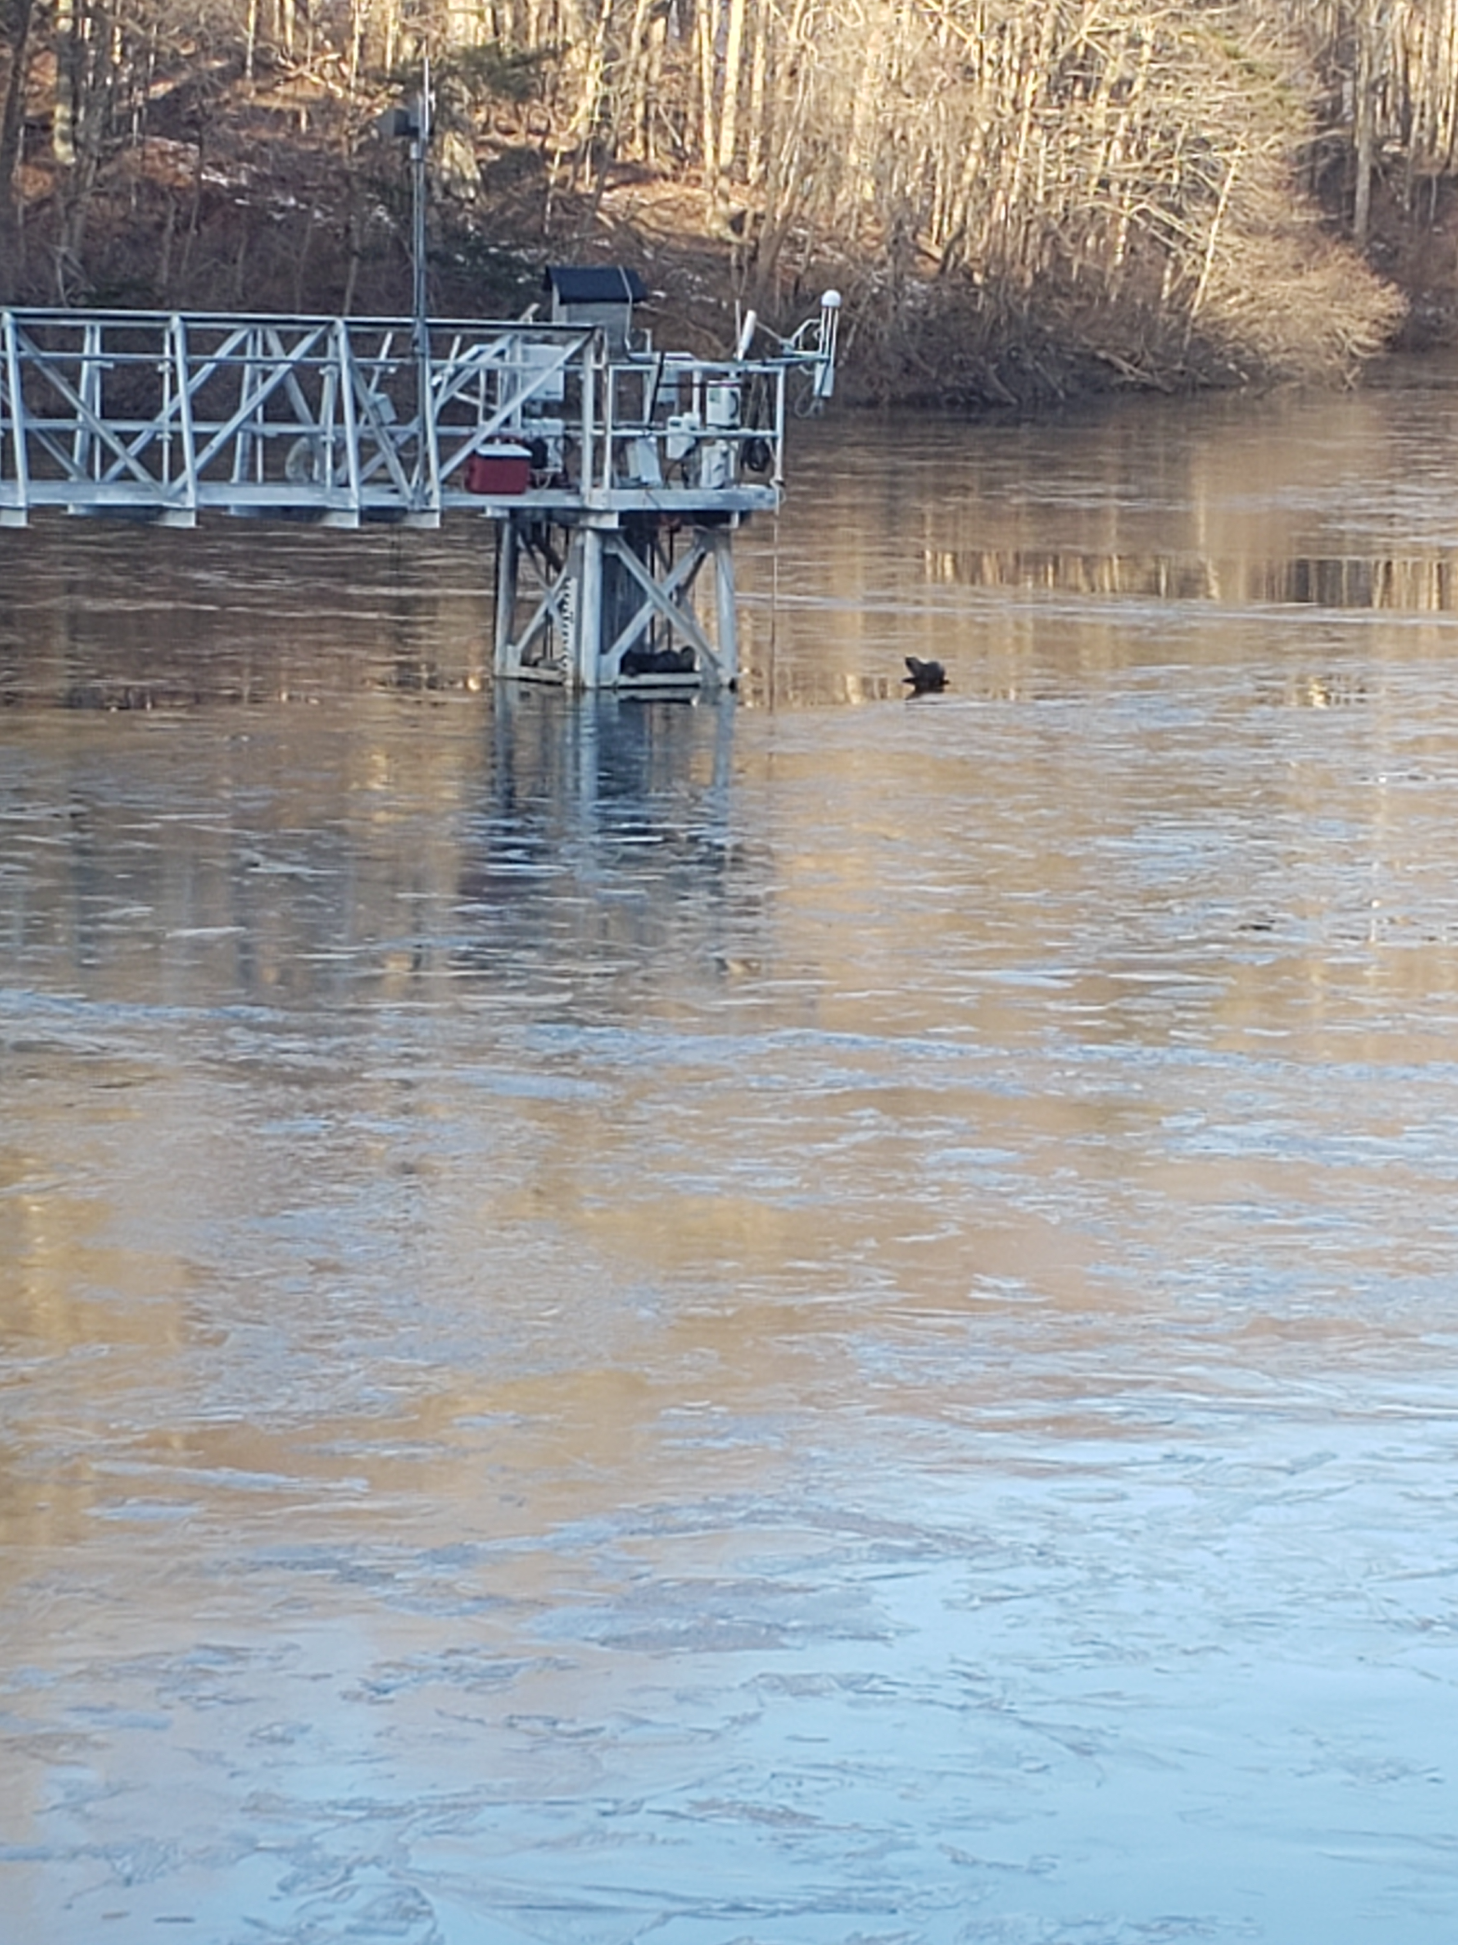
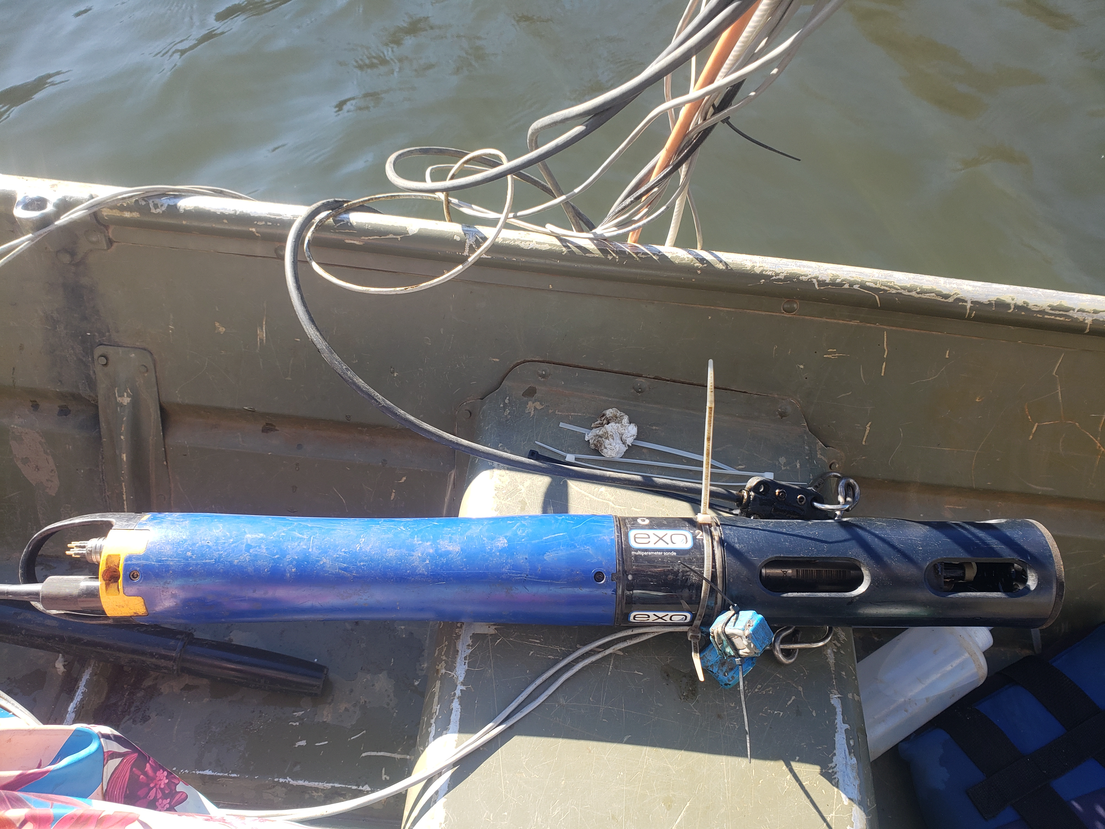
How are high-frequency data collected?
Automated sensors
Attached to buoy, catwalk, etc.
Collect data continuously
Streaming data
Data automatically transmitted
Allows access to real-time data from the reservoir
Catwalk
YSI EXO Sensor
Photo credit: Adrienne Breef-Pilz
Notes:
High-frequency water quality data are often collected using automated sensors. These sensors are deployed in a water body attached to buoys, catwalks, or other structures and collect data continuously. Many of these sensors are automated, which means they can wirelessly stream data to a computer so that it is accessible to managers in near-real time.

Slide 7
Today…
We are going to explore high-frequency water quality data from drinking water reservoirs in southwest Virginia, and then use that data to make water treatment plant operation decisions.
Some of our high-frequency water quality data is collected using a YSI EXO sensor deployed from a catwalk in a drinking water reservoir.
Catwalk
YSI EXO Sensor
Photo credit: Adrienne Breef-Pilz
Notes:
Today, we are going to explore high-frequency water quality data from drinking water reservoirs in southwest Virginia, and then use that data to make water treatment plant operation decisions. For the module, students will explore high-frequency water quality data collected using several different sensors. For example, some of the data are collected using YSI EXO sensor, which is pictured on the bottom right of the slide. This sensor is deployed at a fixed depth in the reservoir, attached to a catwalk. In this module, students will work with turbidity data collected by this sensor.

Slide 8
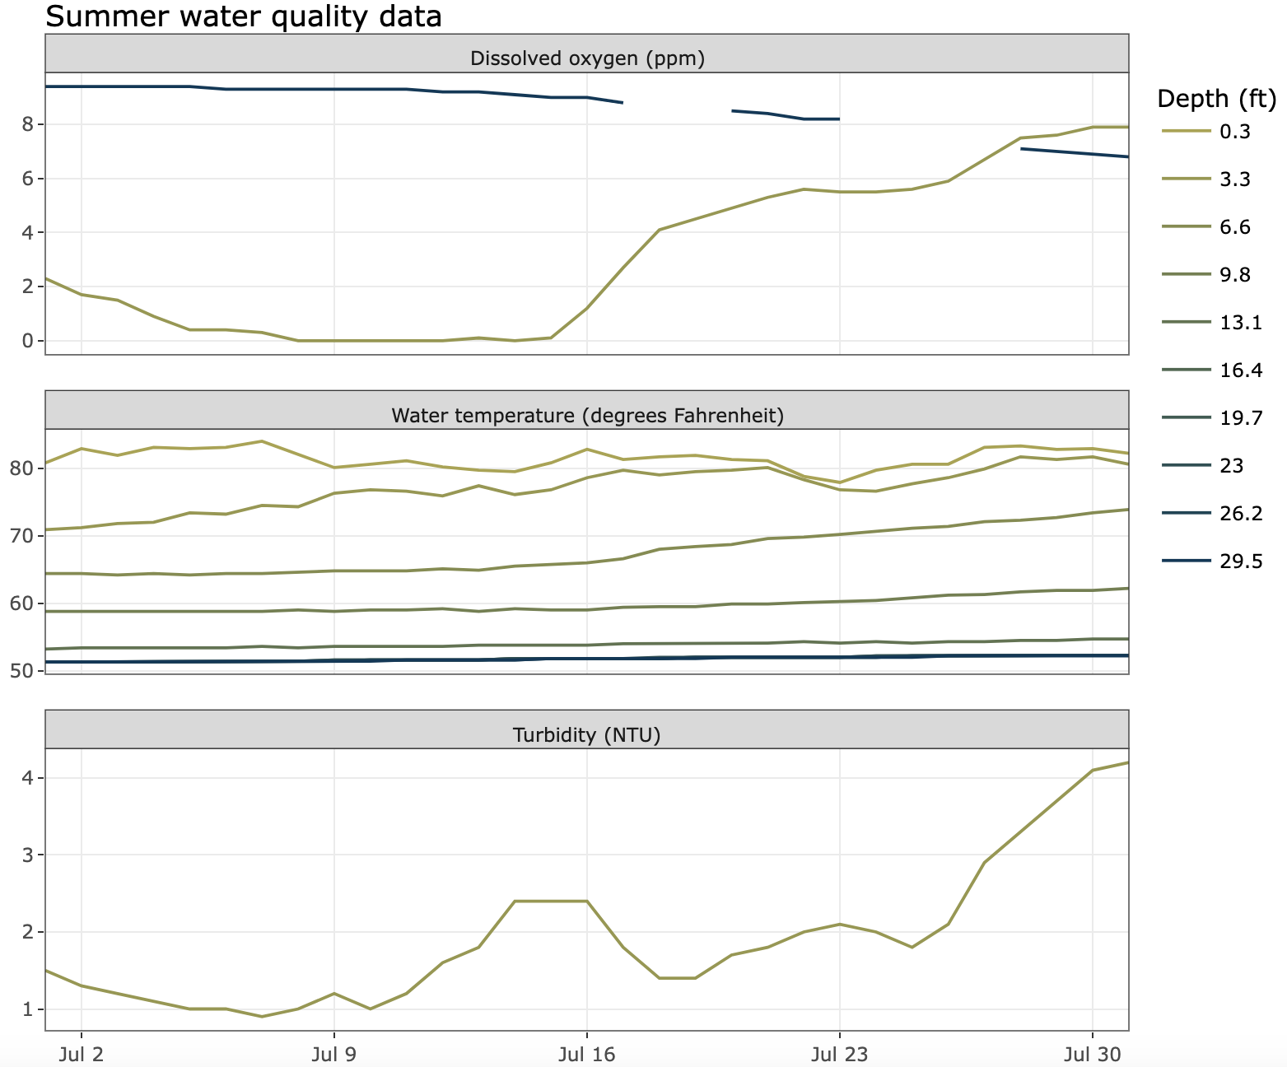
Today…
We are going to explore high-frequency water quality data from drinking water reservoirs in southwest Virginia, and then use that data to make water treatment plant operation decisions.
We will explore the following variables:
Water temperature
Dissolved oxygen (DO)
Turbidity
Notes:
In addition to turbidity, students will also explore water temperature and dissolved oxygen data, which are collected at multiple depths in the reservoir. On the right is an example figure of water temperature, dissolved oxygen, and turbidity data collected from multiple depths in a drinking water reservoir during the summer months. Students will learn how to interpret these data and understand how the data can be used to assess water quality.

Slide 9
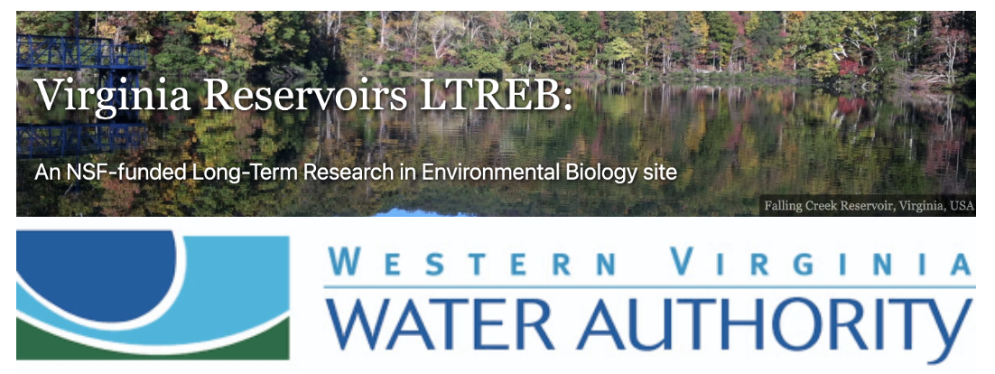
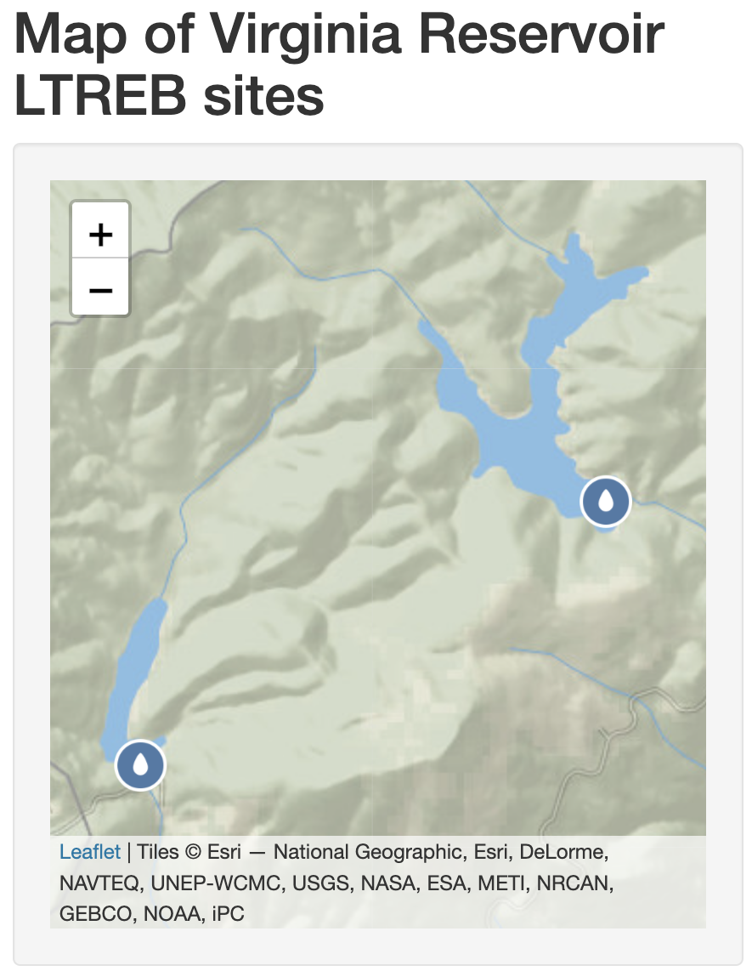
Today…
We are going to explore high-frequency water quality data from drinking water reservoirs in southwest Virginia, and then use that data to make water treatment plant operation decisions.
We will explore data from Falling Creek Reservoir and Beaverdam Reservoir in Vinton, VA.
Notes:
Students will have the option to explore data from one of two reservoirs located in southwest Virginia: Falling Creek Reservoir or Beaverdam Reservoir. Both reservoirs are located in Vinton, Va, near Roanoke, and are owned and operated by the Western Virginia Water Authority as drinking water supply reservoirs.

Slide 10
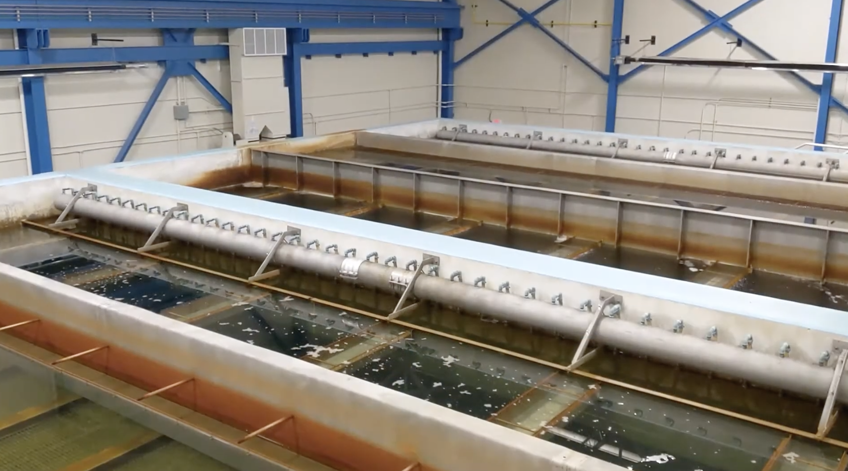
Today…
We are going to explore high-frequency water quality data from drinking water reservoirs in southwest Virginia, and then use that data to make water treatment plant operation decisions.
We will use high-frequency water quality data to inform decisions about water withdrawal depth and water treatment.
Spring Hollow Reservoir Treatment Plant
Photo credit: Western Virginia Water Authority
Notes:
Students will use high-frequency data from their chosen reservoir to make water treatment plant operation decisions. In Activity B, students will use high-frequency water quality data to make decisions about water extraction depth for a drinking water treatment plant. In Activity C, students will use water quality forecasts to make decisions about water treatment to ensure that their plant meets regulatory standards for turbidity on the bottom filter.

Slide 11
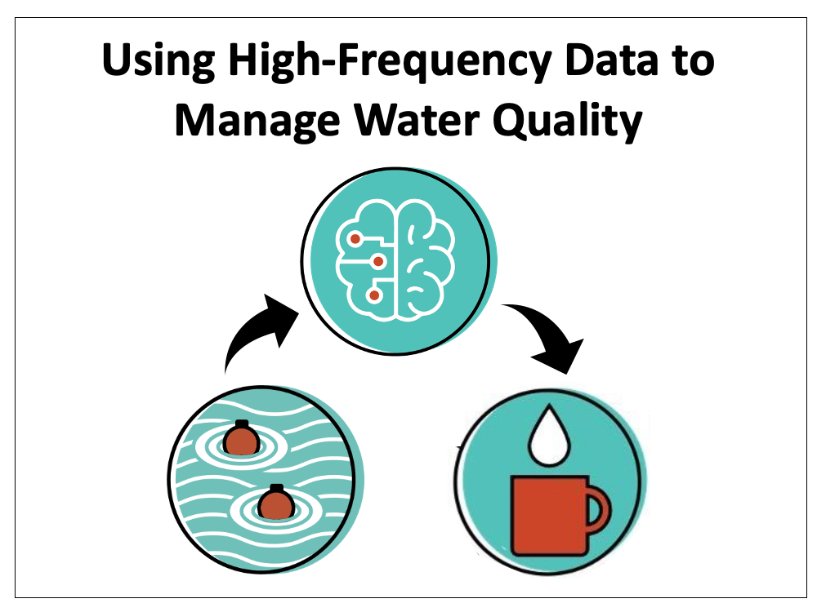
Learning objectives of today’s module:
Define key measures of surface freshwater quality
Explain how water temperature changes over the course of a year in a temperate reservoir and how these changes affect water quality
Interpret high-frequency water quality data to make decisions about water extraction depth for a drinking water reservoir
Evaluate water quality data and forecasts to make decisions about drinking water treatment
Notes:
This module has four learning objectives (read objectives).

Slide 12
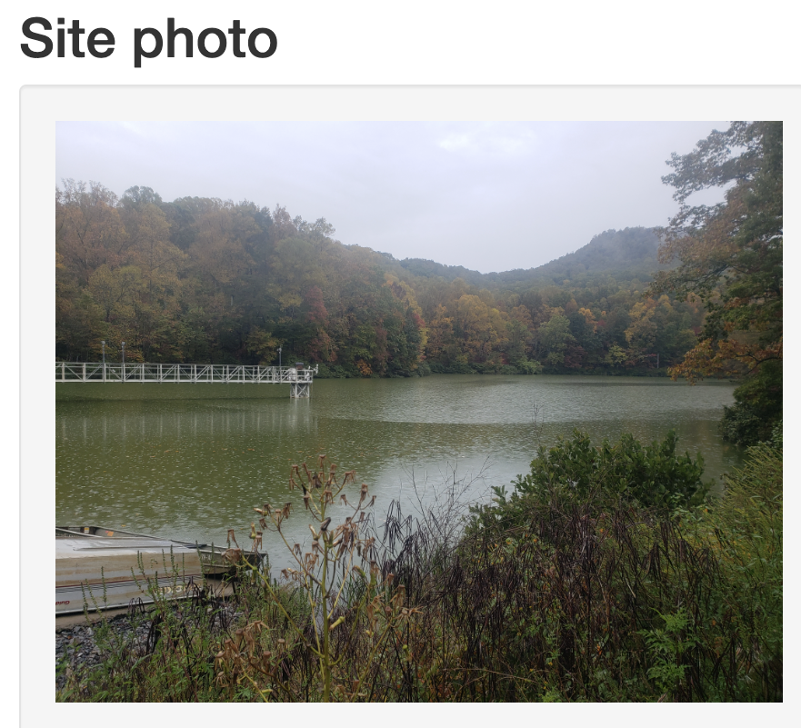
Activity A: Select a site and explore water quality data
Objective 1: Select and learn about a focal drinking water reservoir
Objective 2: Explore real-time high-frequency water quality data from your chosen reservoir
Notes:
I will now give a brief overview of the module activities. In Activity A, students will complete two objectives. First, they will select and learn about a focal drinking water reservoir. Second, they will explore real-time high frequency water quality data from their chosen reservoir.

Slide 13
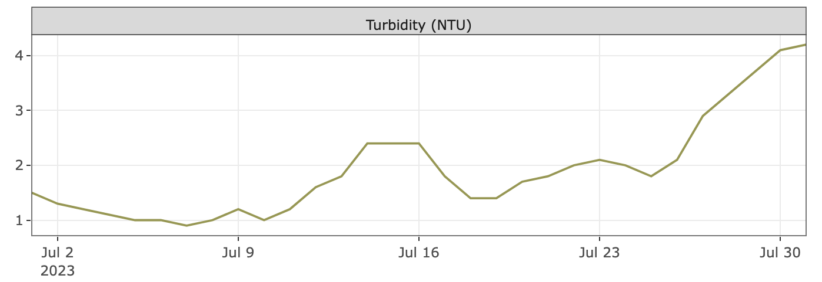
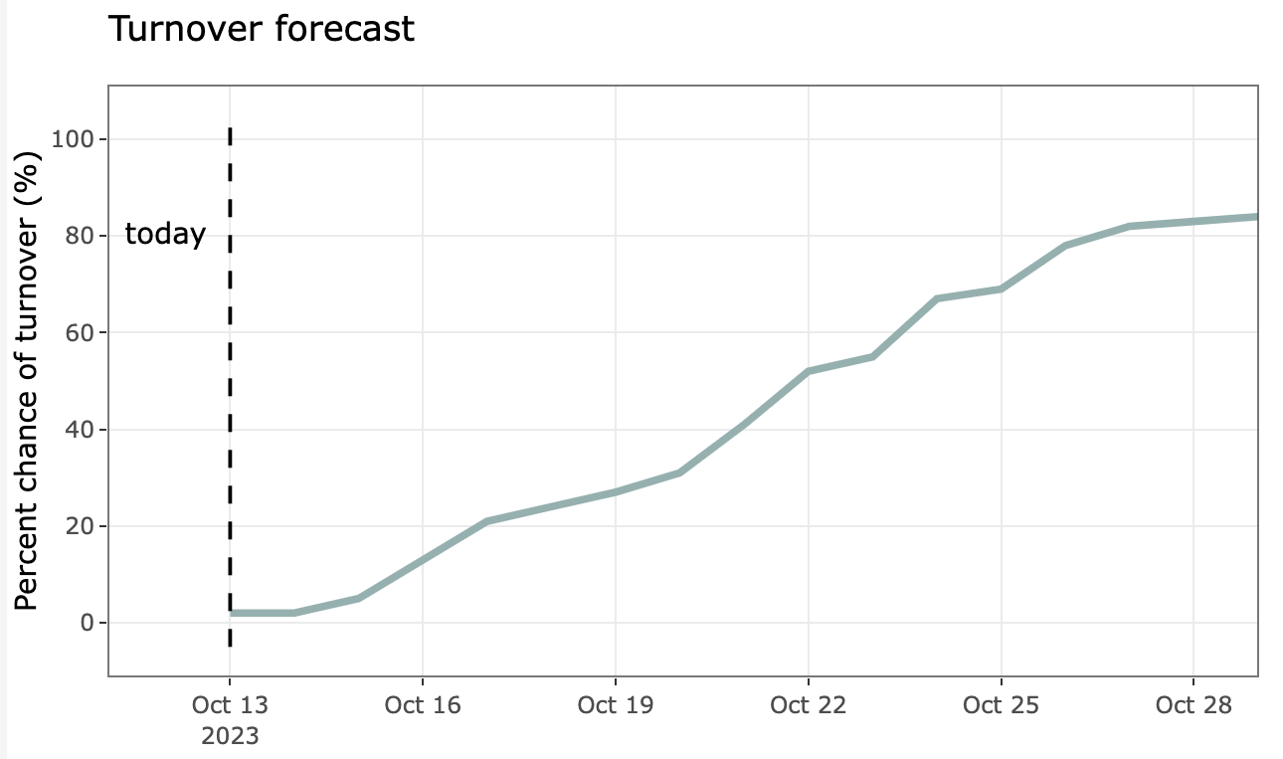
Activity B: Use high-frequency water quality data to make operation decisions
Objective 3: Use high-frequency water quality data to make water withdrawal depth decisions at different times of year
Objective 4: Define water quality forecasting and interpret a fall turnover forecast
Notes:
In Activity B, students will use high-frequency water quality data to make water withdrawal depth decisions at different times of year. Then they will be introduced to key concepts related to water quality forecasting and learn how to interpret a forecast for fall turnover in a reservoir.

Slide 14
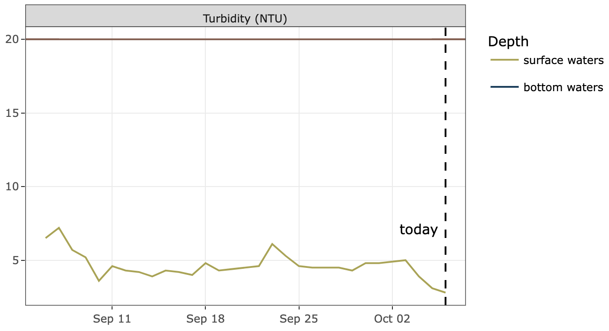
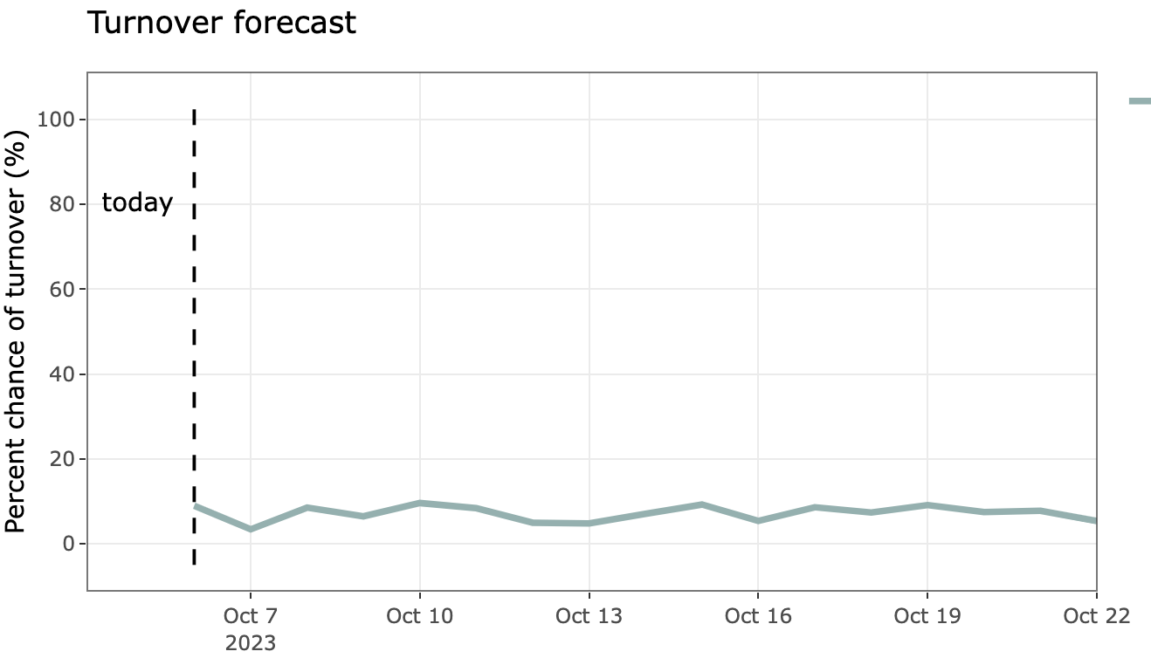
Activity C: Make water treatment decisions using high-frequency water quality data and forecasts
Objective 5: Make water treatment decisions using water quality data forecasts
Notes:
In Activity C, students will complete a scenario which asks them to make water treatment decisions using water quality forecasts.

Slide 15


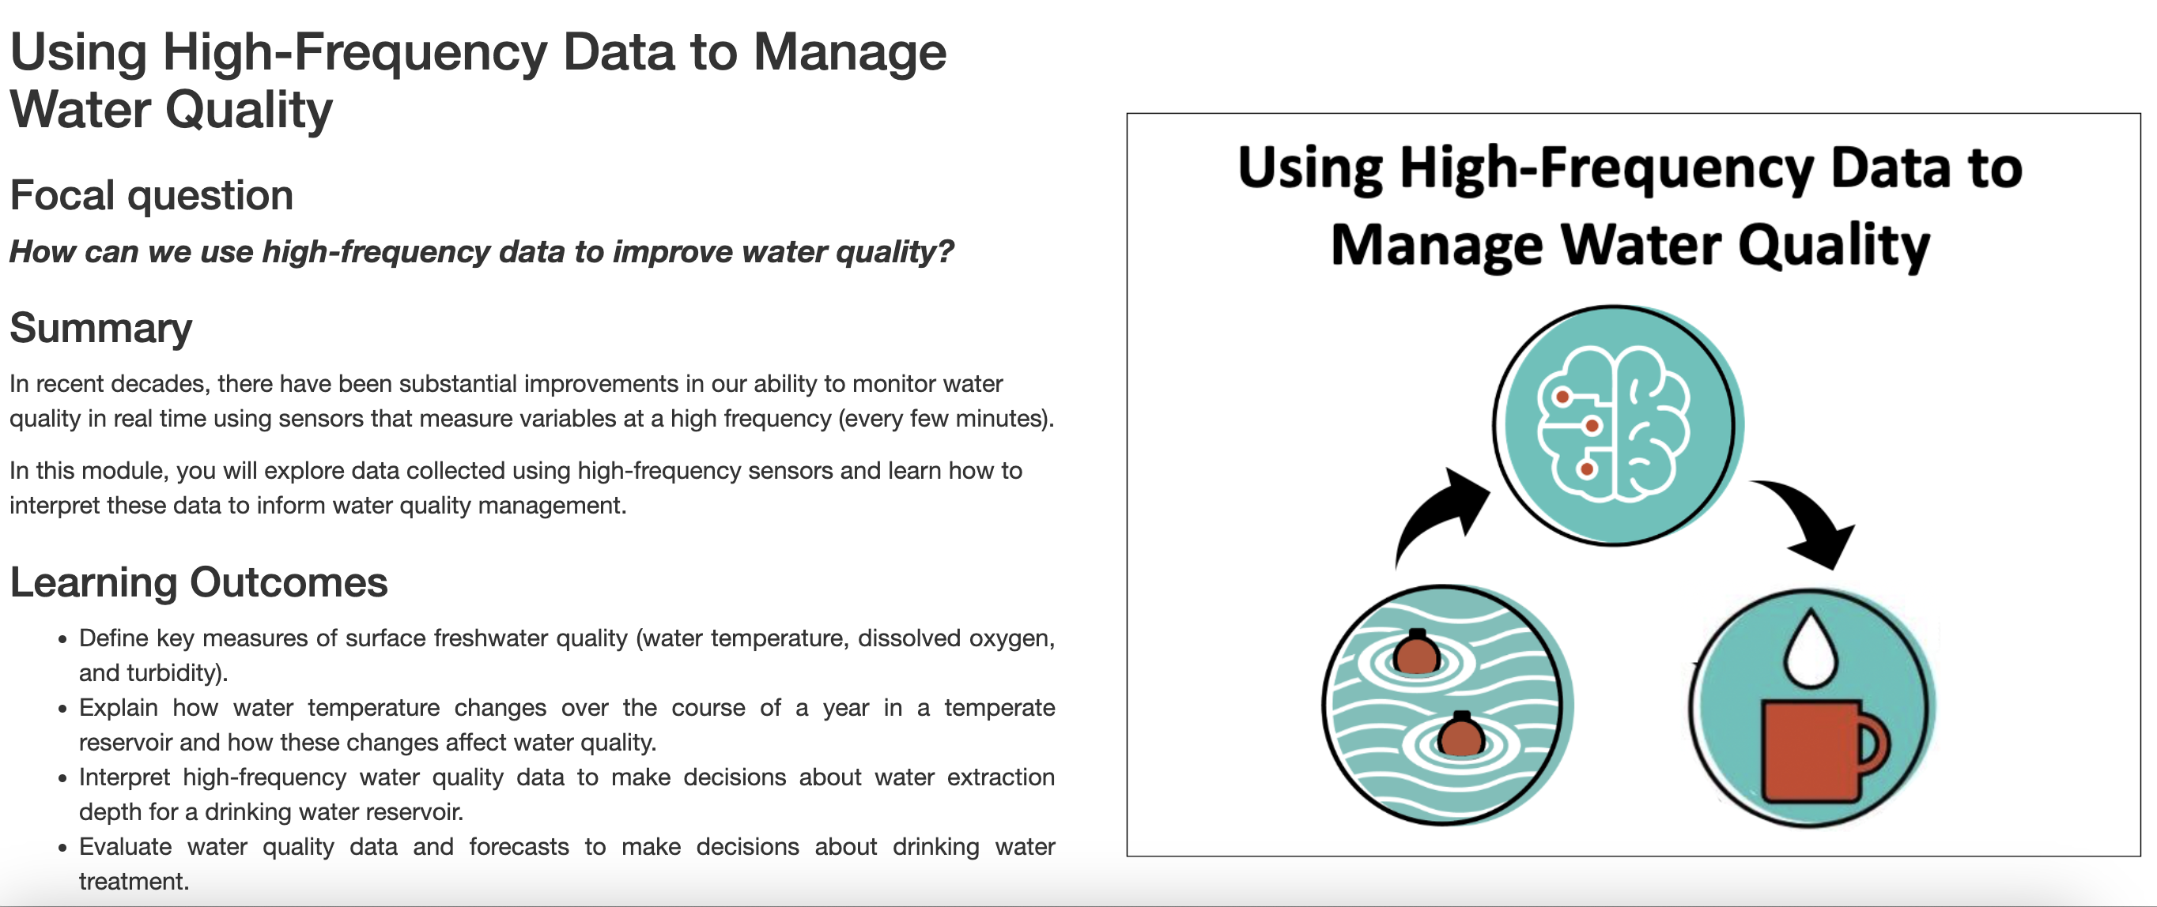
Canvas + Shiny App
The module can be accessed through your course Canvas site
You will complete module activities in an R Shiny app, which is an interactive website
Be sure to complete the ”Quick-start” guide to the module and watch the video that explains the interactive module features
Questions are embedded in the app and you will answer these in a Canvas quiz
Notes:
The module can be accessed through your course Canvas site
You will complete module activities in an R Shiny app, which is an interactive website
Be sure to complete the ”Quick-start” guide to the module and watch the video that explains the interactive module features
Questions are embedded in the app and you will answer these in a Canvas quiz

Slide 16
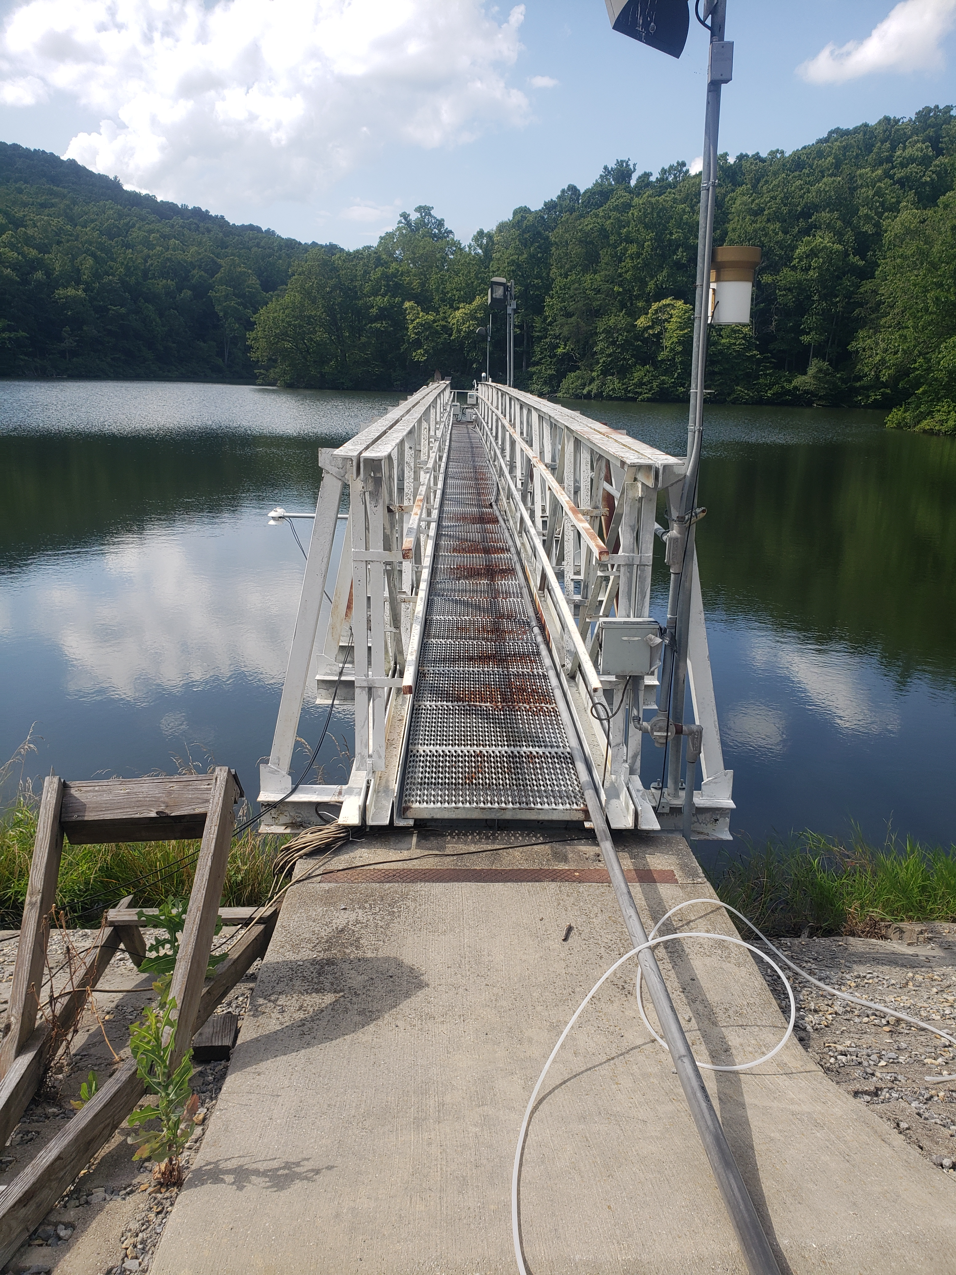
Thank you for participating!
Check out our other water quality & management module:
Module 8: Using Ecological Forecasts to Guide Decision Making
Find out more at: macrosystemsEDDIE.org
Notes:
Thank you for participating!

